Slide 1
Java Basics
Java Technology

Slide 2
Disclaimer
Document Name:
Data Classification: INTERNAL
Disclaimer
The contents of this document are property of Softtek, and are classified as Confidential. Any reproduction in whole or in part is strictly prohibited without the written permission of Softtek.
This document is subject to change. Comments, corrections or questions should be directed to the author.
Audience/Viewership | Purpose
Java Beginners | Training
Revision Chart
The following chart list the revisions made to this document. Use this to describe the changes and additions each time this document is re-published. The description should be detailed as possible and include the names of the reviewers who request the changes.
Version No. | Version Date | Types of Changes | Owner/Author | Date of Review/Expiration
1 | 2015/07/21 | Creation | Luis Robles | NA

Slide 3
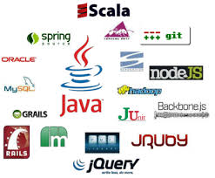
Lesson 1: Java Technology

Slide 4
What is Java?
Java is a programming language and computing platform
The Java programming language is a high-level language
Java is fast, secure, and reliable
Java is everywhere!
From laptops to datacenters, game consoles to scientific supercomputers, cell phones to the Internet.
The Java platform has two components:
The Java Virtual Machine: it's the base for the Java platform and is ported onto various hardware-based platform.
The Java Application Programming Interface (API): The API is a large collection of ready-made software components that provide many useful capabilities.

Slide 5
What is Java Technology
A programming language
As a programming language, Java can create all kinds of applications that you could create using any conventional programming language.
A development environment
As a development environment, Java technology provides you with a large suite of tools:
A compiler (javac)
An interpreter (java)
A documentation generator (javadoc)
A class file packaging tool
and so on...
An application environment
Java technology applications are typically general-purpose programs that run on any machine where the Java runtime environment (JRE) is installed.
A deployment environment
There are two main deployment environments:
The JRE contains the complete set of class files for all the Java technology packages, which includes basic language classes, GUI component classes, and so on.
Web browser. Most commercial browsers supply a Java technology interpreter and runtime environment.

Slide 6
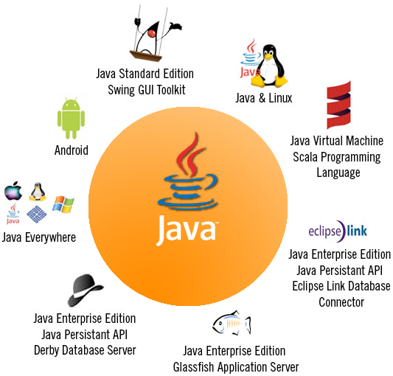
Characteristics
Java is a versatile, secure, portable and efficient platform, meet dynamic business needs and gives power to develop new innovative solutions which are platform independent and provide flexibility to face market challenges.

Slide 7
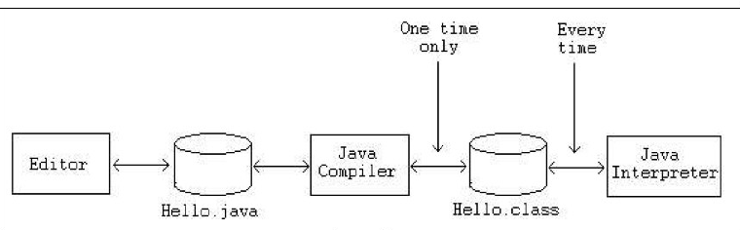
Phases of a Java Program
.java files are text files
.class files are Java bytecode files (source code compiled as binary file)

Slide 8
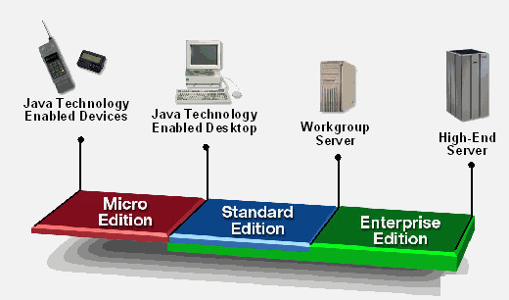
Java Platform
Java is generally thought of in terms of four platforms.
Standard Edition (SE) or JavaSE
Enterprise Edition (EE) or JavaEE
Micro Edition (ME) or JavaME
Java Fx
Notes:
What Is JavaFX
JavaFX is powered by Java. The JavaFX platform enables application developers to easily create and deploy Rich Internet Applications (RIA) that behave consistently across multiple platforms. JavaFX extends the power of Java by allowing developers to use any Java library within JavaFX applications. This way developers can expand their capabilities in Java and make use of the presentation technology that JavaFX provides to build engaging visual experiences.
“JavaFX (is) replacing Swing as the new client UI library for Java” which is why it makes sense as Java developers that we start taking JavaFx seriously and start embracing it as the best way to build applications in Java.
JavaFX is a software platform for creating and delivering desktop applications, as well as rich internet applications (RIAs) that can run across a wide variety of devices. JavaFX is intended to replace Swing as the standard GUI library for Java SE, but both will be included for the foreseeable future.
JavaFX has support for desktop computers and web browsers on Microsoft Windows, Linux, and Mac OS X.

Slide 9
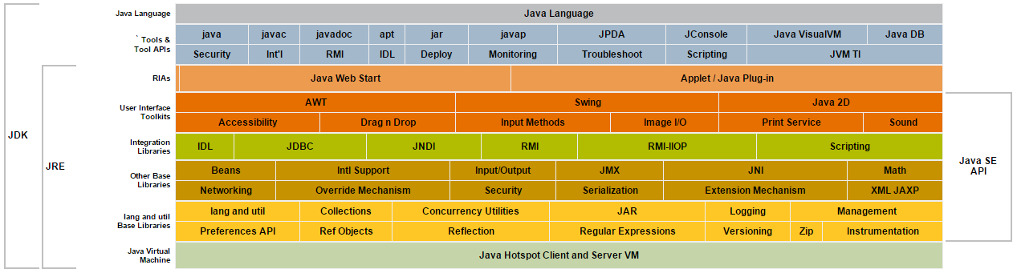
JavaSE API
Java Conceptual Diagram (JavaSE 6):
Notes:
Share some specific characteristics of JavaSE 6.

Slide 10
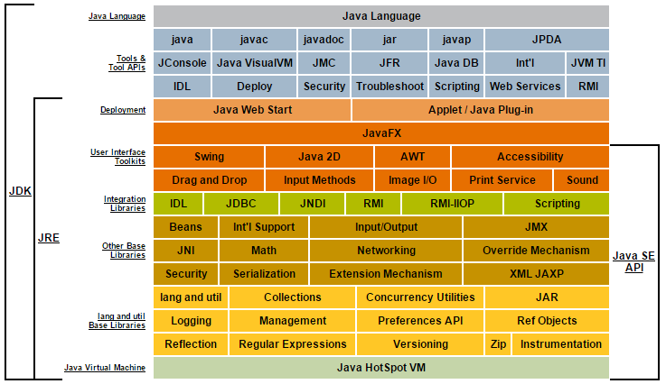
JavaSE API (cont)
Java Conceptual Diagram (JavaSE 7)
Notes:
Share some differences between JavaSE 6, 7 and 8.

Slide 11
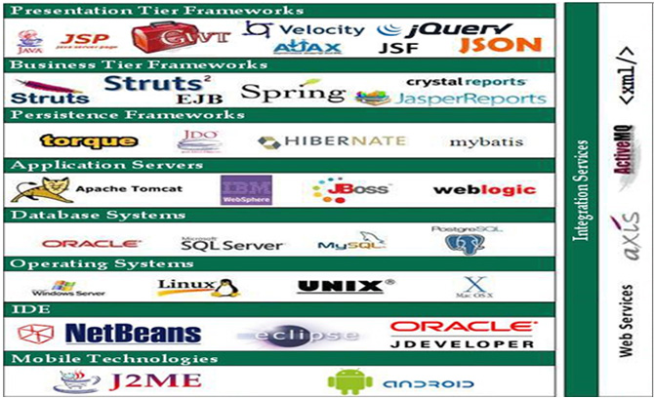
Java Frameworks/Products by Tier
There are a lot of OpenSource, Free and Commercial frameworks/products to develop Enterprise Solutions based on Java

Slide 12







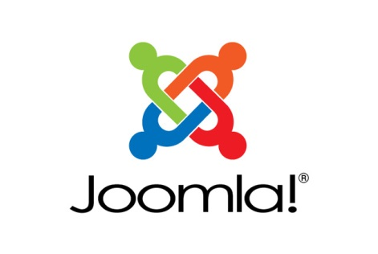


OpenSource/Commercial products
Some products based on Java

Slide 13
Virtual Machine and JDK
Java Virtual Machine (JVM) or Java Runtime Environment (JRE) is where all Java programs are executed.
Java Development Kit (JDK) is the compiler of java programs, JDK includes the JRE. But also includes a java library (classes) and command to compile and execute java programs.
A few of these commands are: java.exe, javaw.exe, javac.exe, javadoc.exe, javah.exe, etc.

Slide 14
Class
A class is a template used to create objects. They are made up of members, the main two of which are fields and methods. Fields are variables that hold the state of the object, while methods define what the object can do.
OBJECT CREATION:
To access a class’s fields and methods from outside the defining class, an object of the class must first be created. This is done by using the new keyword, which will create a new object in the system’s memory.
An object is also called an instance. The object will contain its own set of fields, which can hold values that are different to those of other instances of the class.

Slide 15
Class
ACCESSING OBJECT MEMBERS
In addition to creating the object, the members of the class that are to be accessible beyond their package need to be declared as public in the class definition.
The members of this object can now be reached by using the dot operator after the instance name.

Slide 16
Packages
Packages are used to avoid naming conflicts and to organize code files into different directories.
package mypackage; // this file belongs to mypackage
Packages may be any number of directory levels deep and the levels in the hierarchy are separated by dots.
package sub.mypackage;

Slide 17
Packages
IMPORT PACKAGES
An import statement must be located before all other members in the code file, and it has no other purpose than to free the programmer from having to type the fully qualified name.
import mypackage.sub.MyClass;
import java.util.*;
import static java.lang.Math.*;

Slide 18
Methods
DEFINING METHODS
Methods are reusable code blocks that will only execute when called.
Can be created by typing void followed by the method’s name, a set of pharenteses and a code block.
The void keyword means that the method will not return a value.

Slide 19
Methods
CALLING METHODS
To call a method of a class, we MUST first create an instance of that class.
The dot operator is used after the instance’s name in order to access its members, wich include the methods.

Slide 20
Methods
METHODS PARAMETERS
Are used to pass arguments to the method.
The corresponding parameters MUST first be added to the method declaration in the form of a comma separated list.
A method can be defined to take any number of arguments and they can have any data types, just ensure the method is called with the same types and number of arguments.
To be precise, parameters appear in method definitions, while arguments appear in method calls. However, the two terms are sometimes used interchangeably.

Slide 21
Methods
RETURN STATEMENT
A method can return a value. The void keyword is then replaced with the data type the method will return, and the return keyword is added to the method body with an argument of the specified return type.
Return is a jump statement that causes the method to exit and return the specified value to the place where the method was called.
The return statement may also be used in void methods to exit before the end blockis reached.

Slide 22
Variables
Variables are used for storing data during program execution.
DECLARING VARIABLES:
To declare (create) a variable you start with the data type you want it to hold followed by a variable name. The name can be anything you want, but it is a good idea to give your variables names that are closely related to the values they will hold:
int myInt;
String name;

Slide 23
Variables
ASSIGNING VARIABLES:
To give the variable a value you use the assignment operator (=) followed by the value.
When a variable is initialized (assigned a value) it then becomes defined (declared and assigned).
myInt = 10; name=“Robert”;
USING VARIABLES:
Once a variable has been defined it can be used by simply referencing the variable’s name, for example to print it.
System.out.print(myInt);

Slide 24
Constructors
The class can have constructor. This is a special kind of method used to initiate (construct) the object.
It always has the same name as the class and does not have a return type.
To be accesible from another class not in its package it needs to be declared with the public Access modifier.

Slide 25
Links and References
https://www.java.com/en/about/
http://docs.oracle.com/javase/6/docs/
http://docs.oracle.com/javase/7/docs/
https://docs.oracle.com/javafx/2/overview/jfxpub-overview.htm

Slide 27
Luis Robles
luisf.robles@softtek.com
Related to training material (Java Basics module)
Sarahi Flores
sarahi.flores@softtek.com
Instructor

